Slide 1



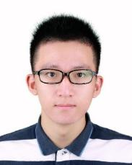
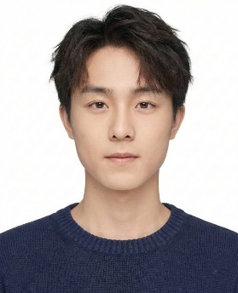
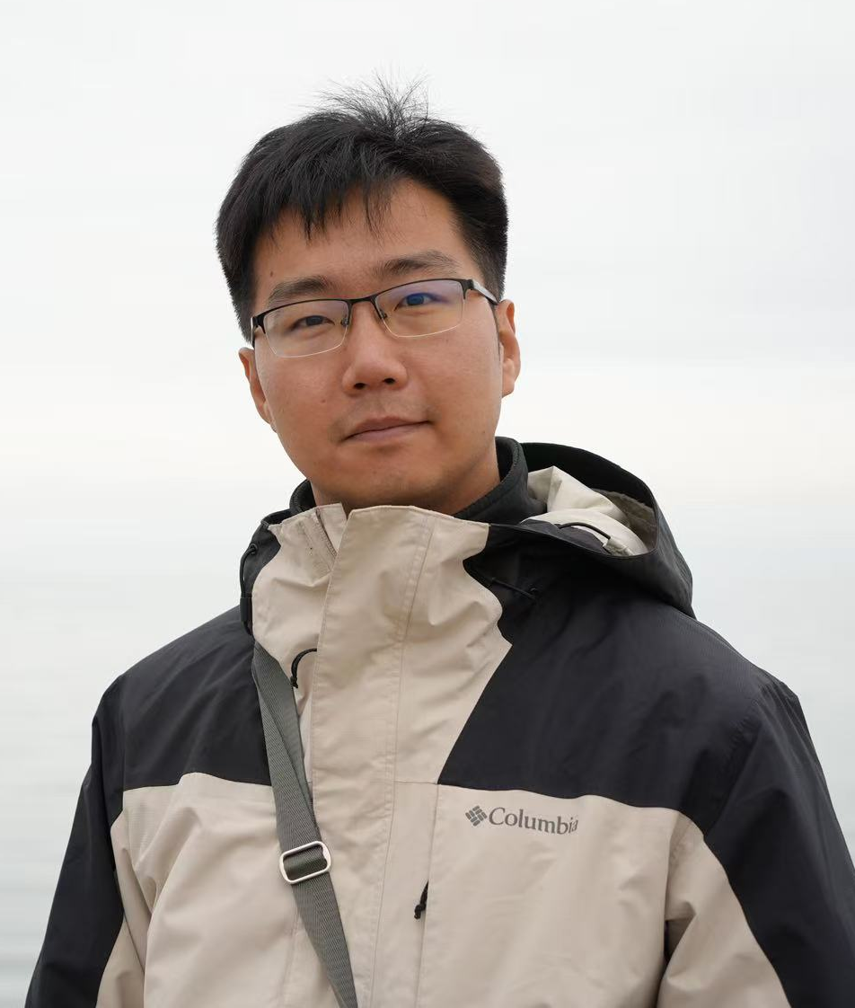
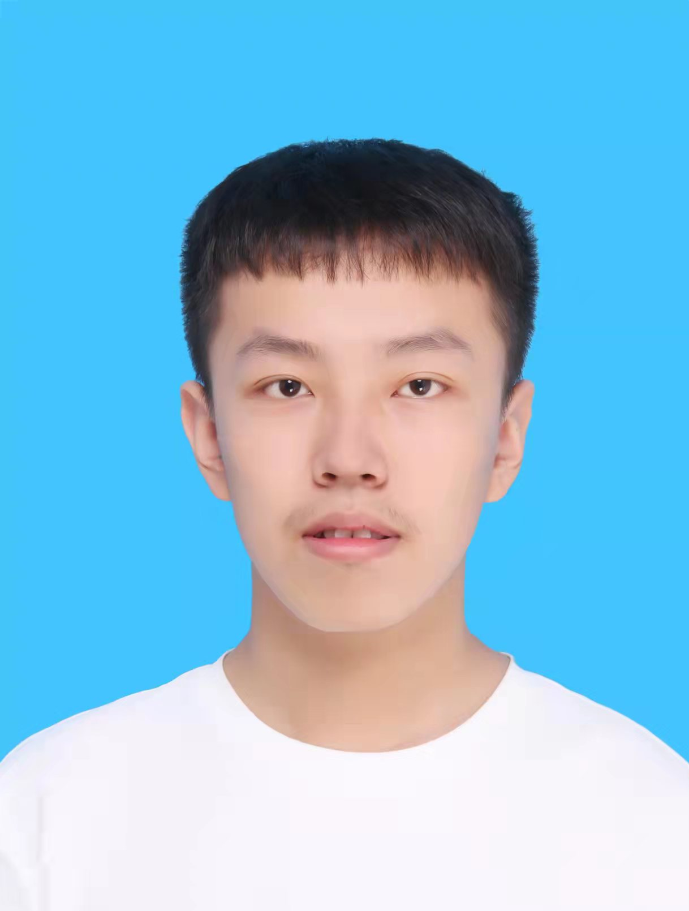
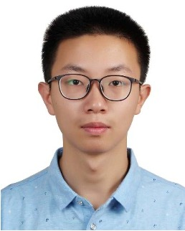

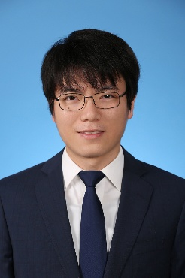
Domain Feature Enhanced Unisolver for Weak Lensing Inference
THUML, School of Software, Tsinghua University
Huikun Weng
Haonan ShangGuan
Haixu Wu
Yuezhou Ma
Hang Zhou
Yuanxu Sun
Mingsheng Long

Slide 2
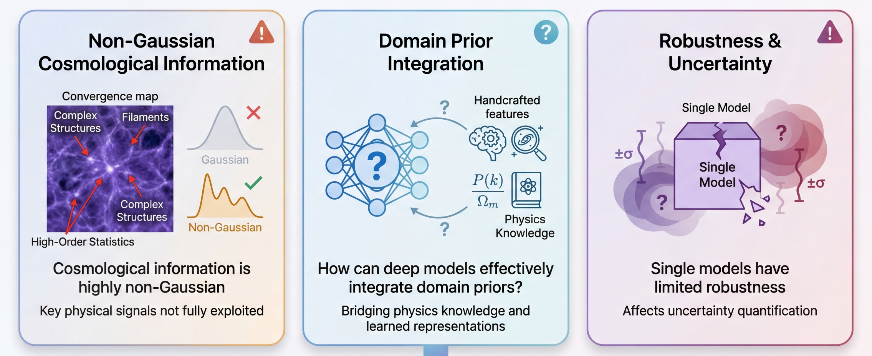
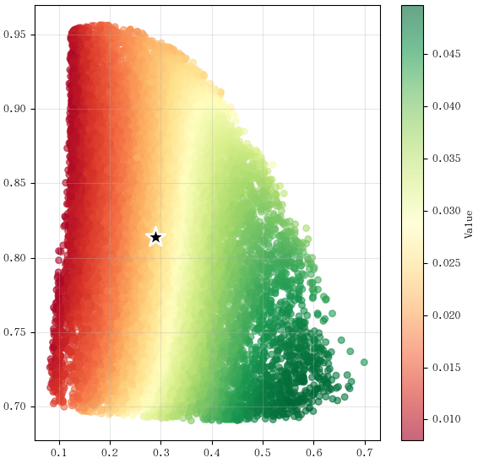

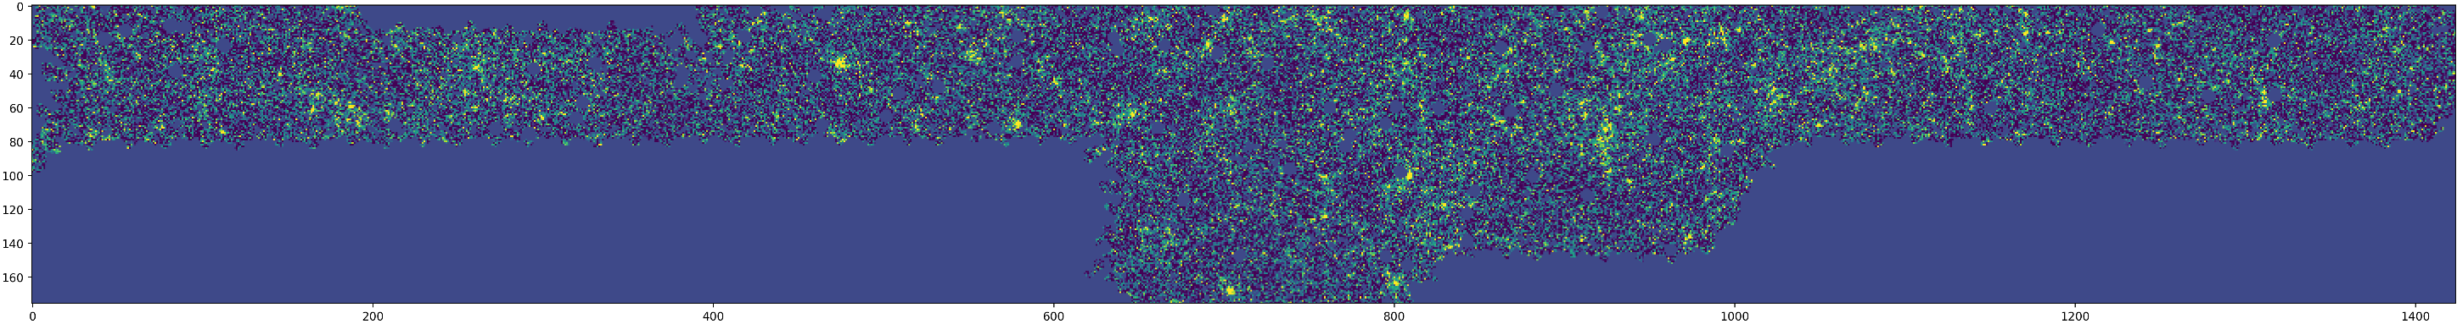
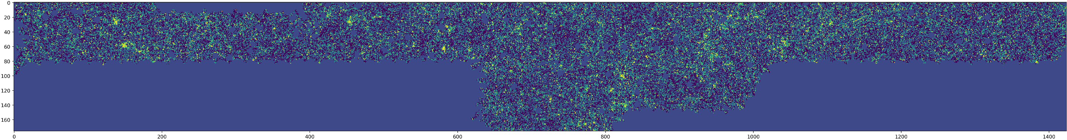
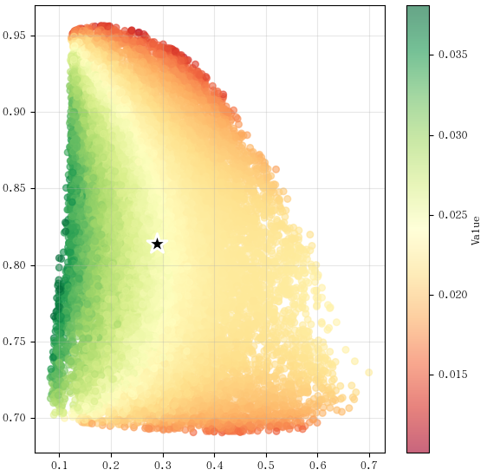

Challenges in Weak Lensing Inference
Scientific problem: requires capturing physical information behind observation
Learning difficulty: effectively integrate both deep representations and domain priors
Ill-posed problem: inferring underlying coefficients from partial observations

Slide 3
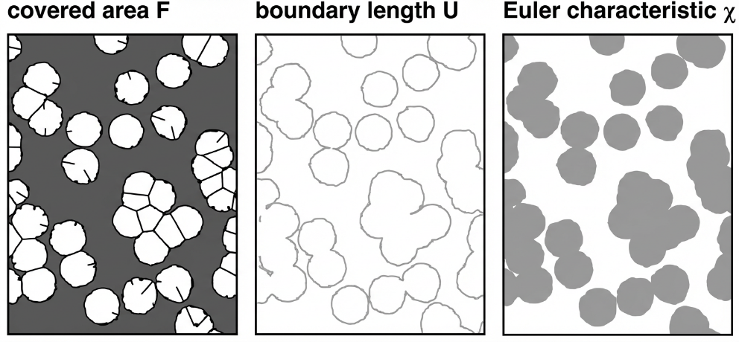
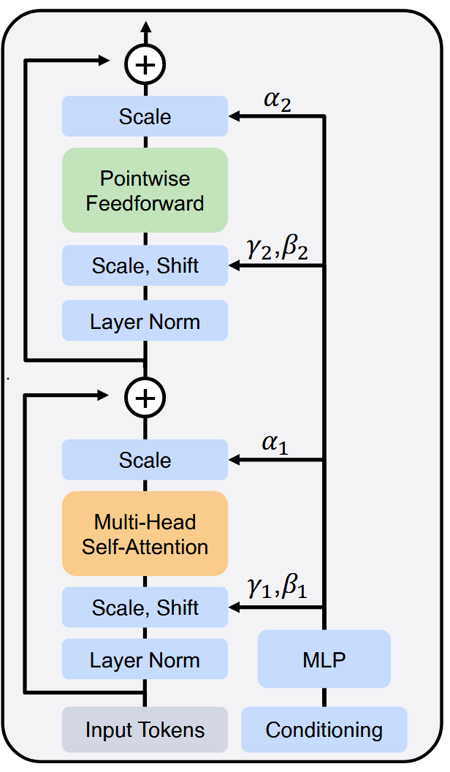
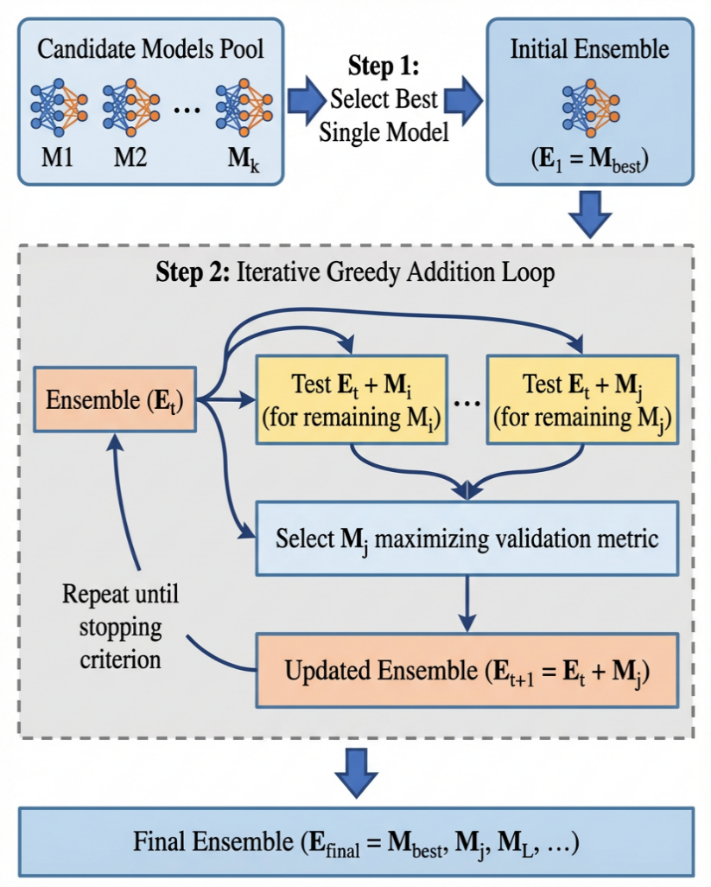
Key Designs in Our Method
(1) Elaborated Domain Prior
(2) Specialized Conditional Transformer
(3) Robust Ensemble Algorithm
Power Spectrum
Peak Counts
Minkowski Functionals
Multiscale Wavelet Statistics
1-point PDF
... ... ...
Zhou et al., Unisolver: PDE-Conditional Transformers Towards Universal Neural PDE Solvers, ICML 2025

Slide 4
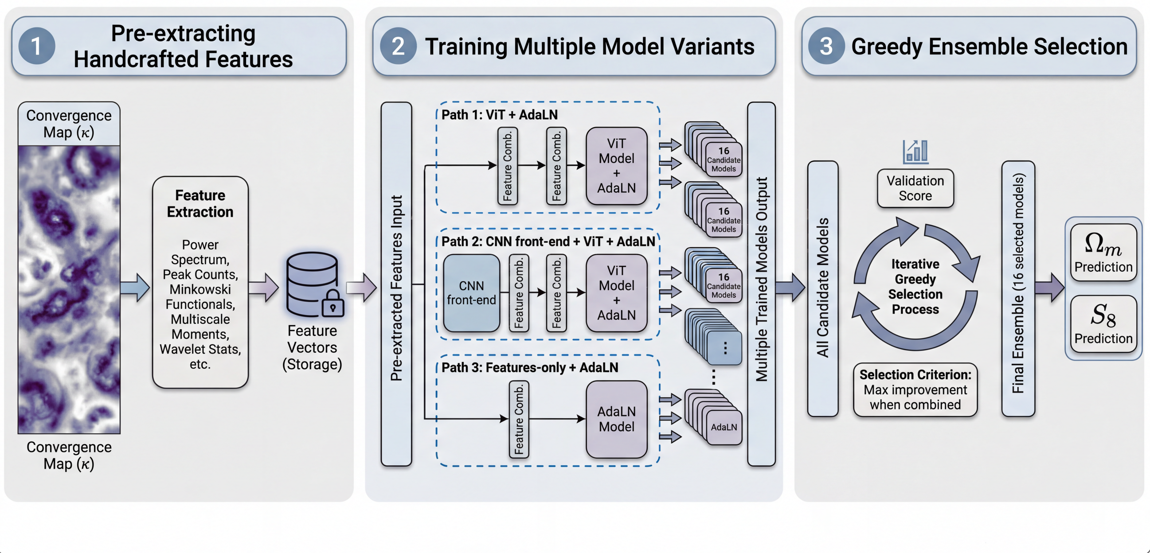

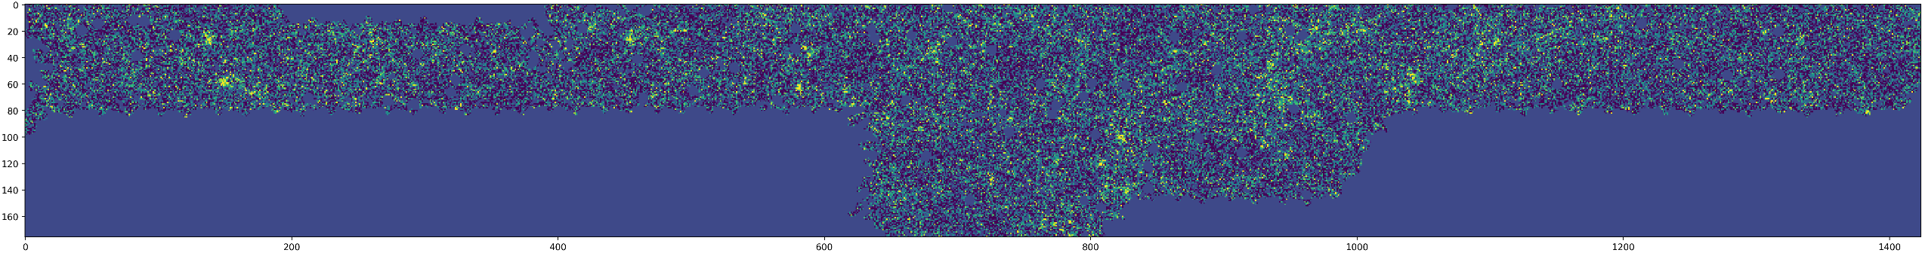
Overall Training and Inference Pipeline

Slide 5

Stage 1: Starting From Domain Priors
Weak lensing is a highly structured physics signal, not arbitrary images.
Domain-specific priors are based on decades of accumulated knowledge in the field.
Effectively capture information from low signal-to-noise ratio cosmological observations

Slide 6
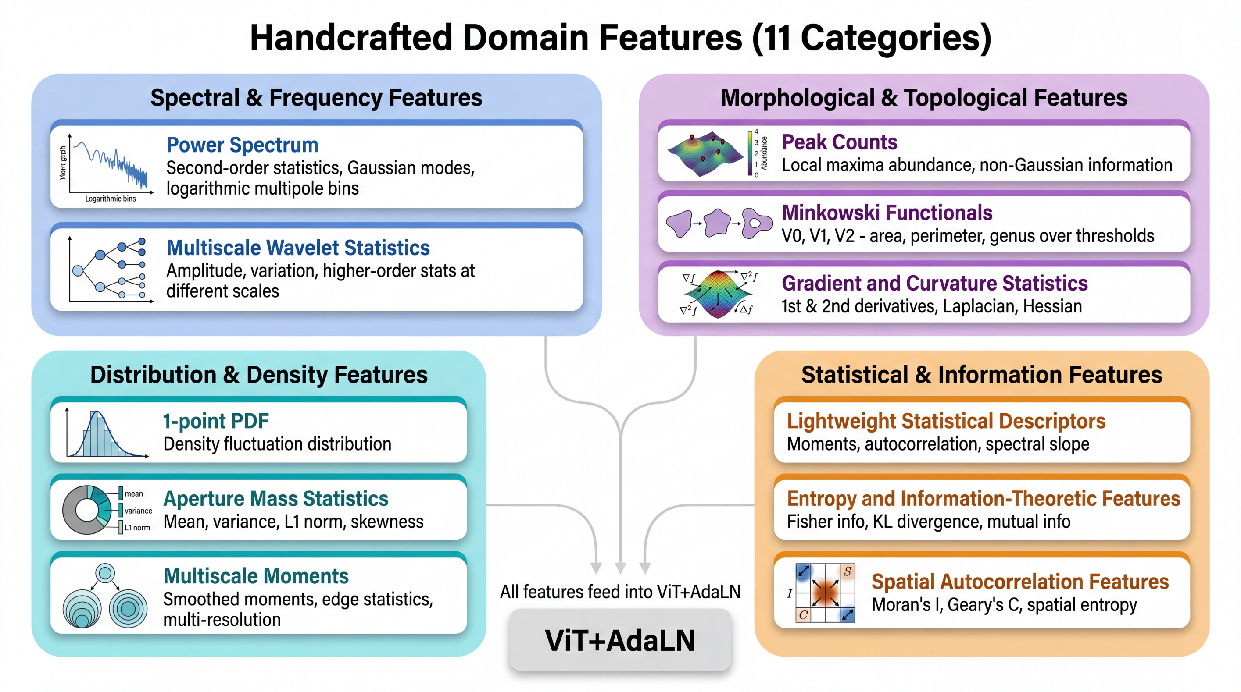
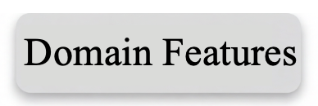
Stage 1: Domain Features (11 Categories)

Slide 7
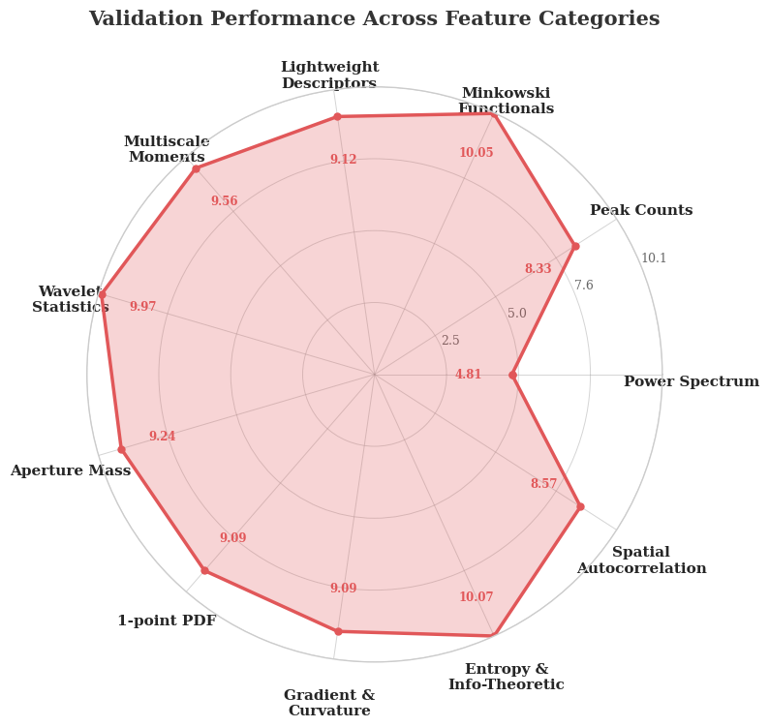
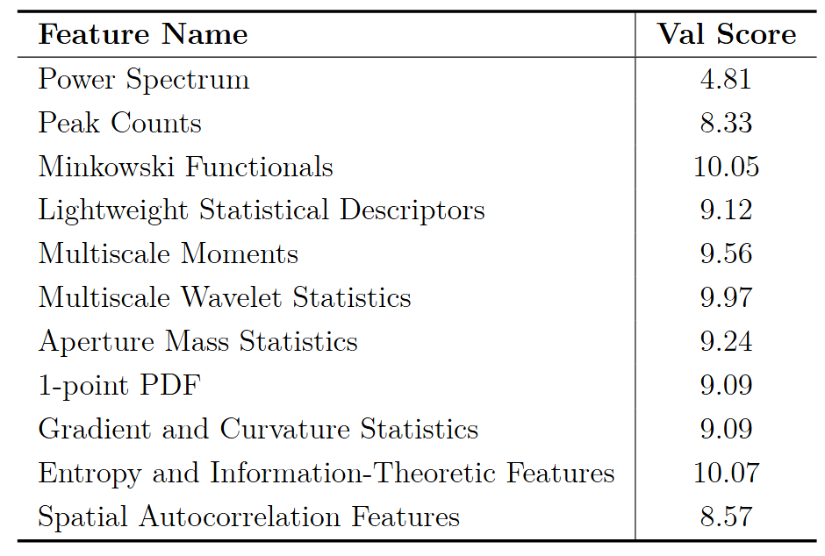
Stage 1: Performance of Each Domain Feature
Splits the public data for train and val as 8:2.
Linearly regress the coefficients with MLP.
🏆
🏆
🏆

Slide 8
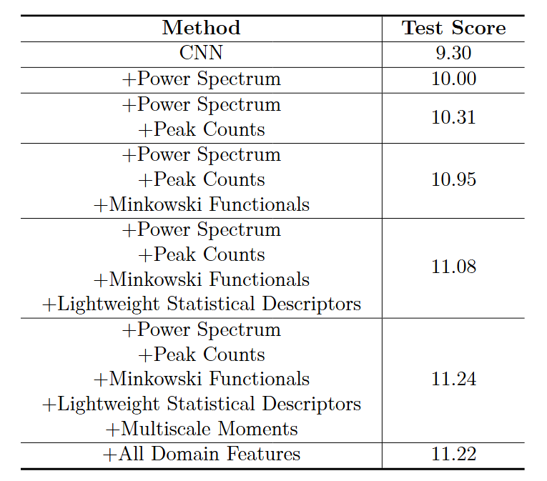
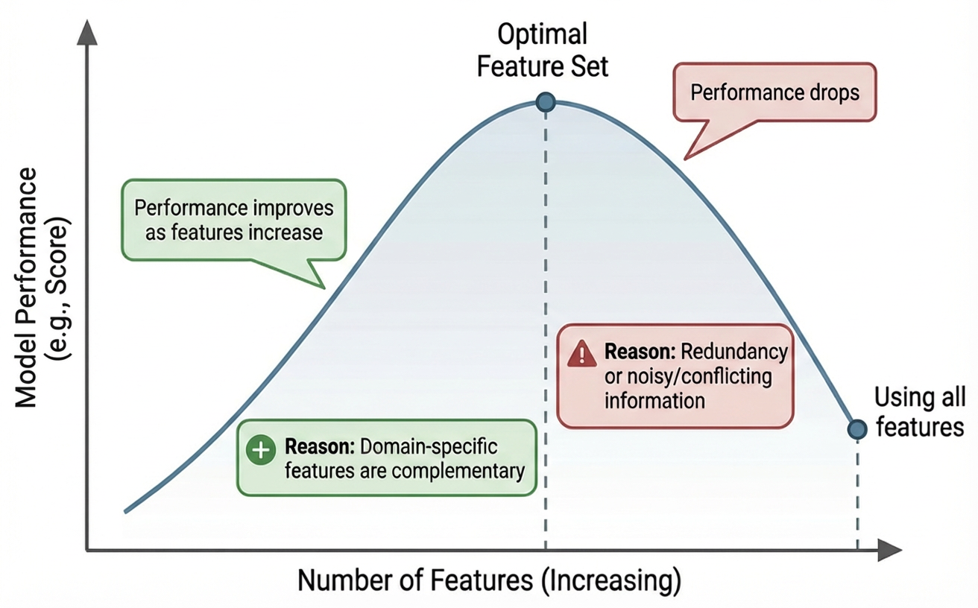
Stage 1: Complementarity Among Domain Features
There exists a hidden complementarity among the 11 extracted domain features.
But, Too Many Cooks Spoil the Broth.

Slide 9
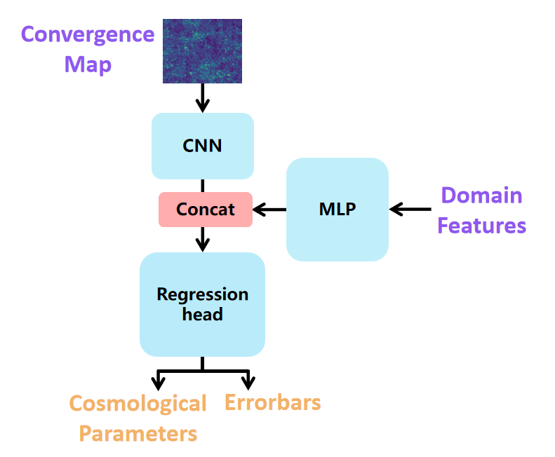
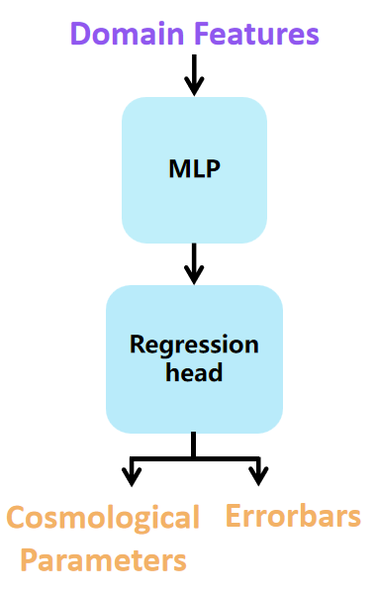
Stage 2: Integrating Deep and Domain features
Architecture 1: Only domain features
Architecture 2: Simple integration in the last layer
The above two simple architectures were explored. Performance gains were limited.

Slide 10
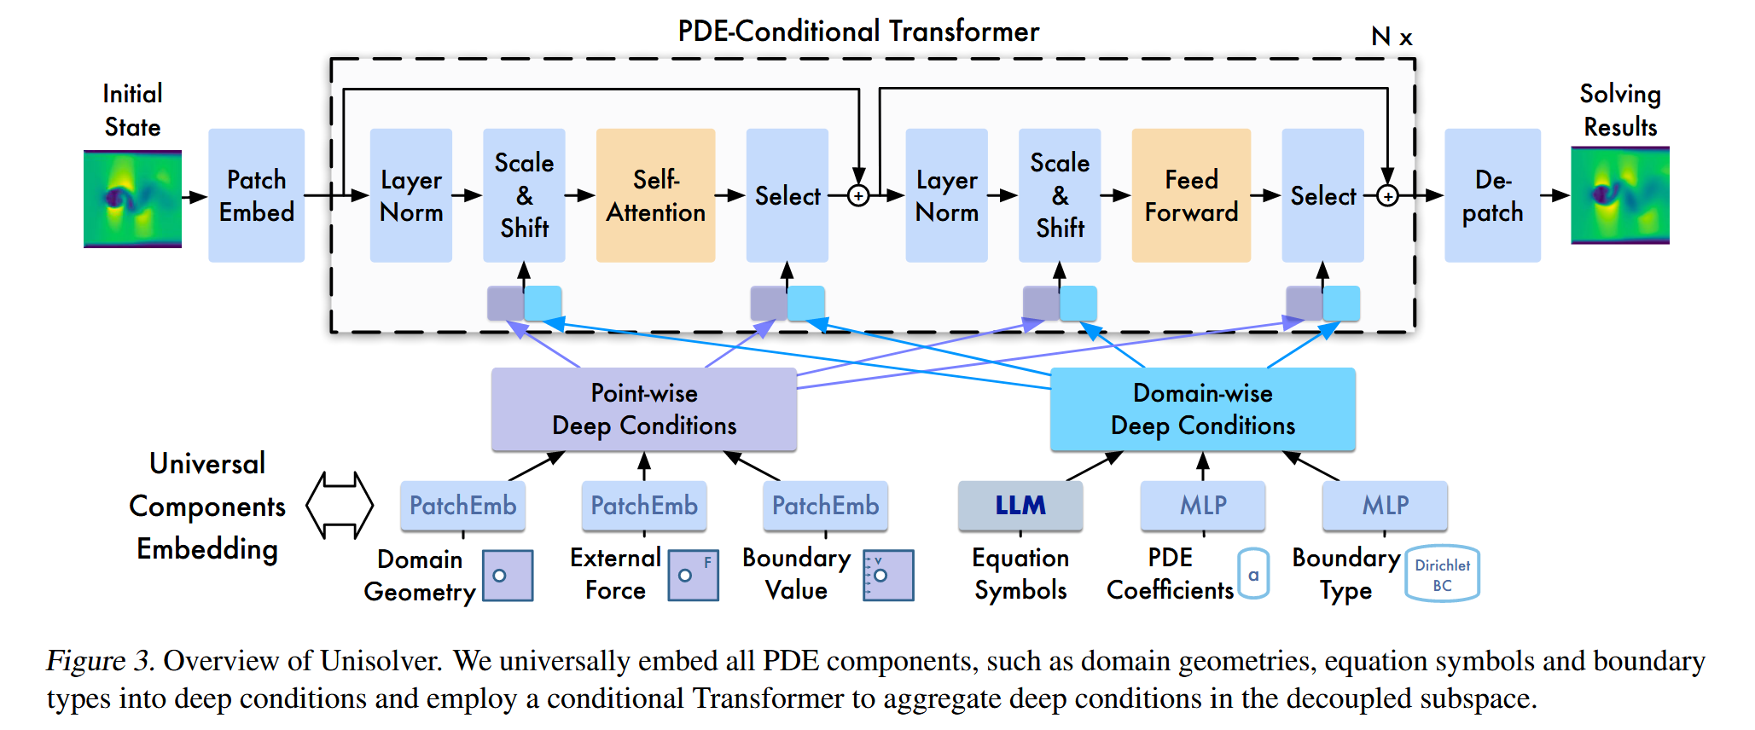
Stage 2: PDE-Conditional Transformer (Unisolver)
Zhou et al., Unisolver: PDE-Conditional Transformers Towards Universal Neural PDE Solvers, ICML 2025

Slide 11

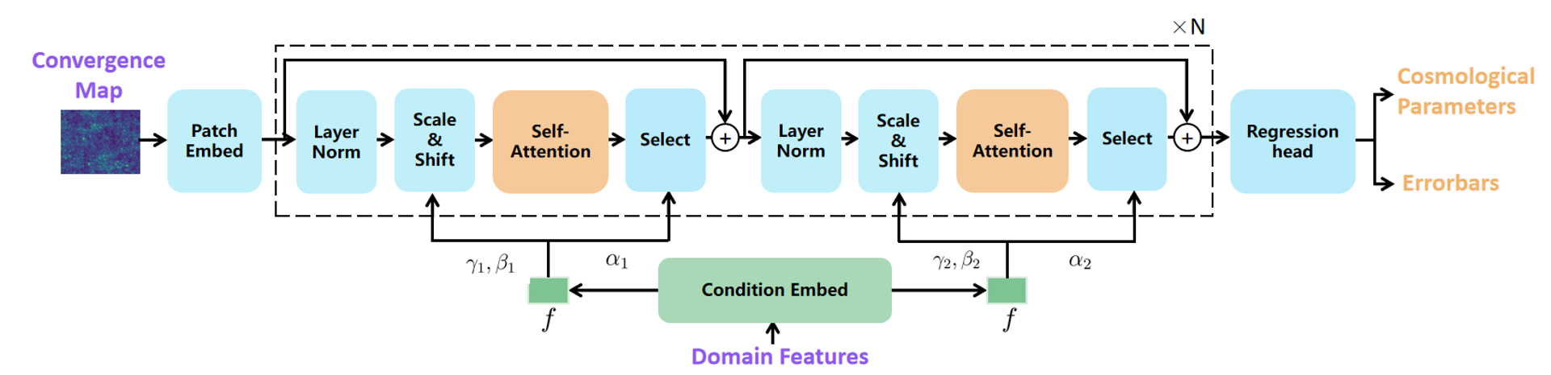
Stage 2: From PDE to Cosmology
Domain-Feature-Conditioned Unisolver
global physical context
From CNN-based to Transformer-based architecture; Enhanced model capacity!
Adaptively rescale and shift internal representations based on cosmological conditions.
Notes:
Condition Embedder
Maps the input handcrafted feature vector into a global physical context that is used in the AdaLN layers
Patch Embedding with Positional Encoding
Divides convergence maps into patches, flattened and projected into a latent space
Each patch is augmented with a spatial distance encoding
Transformer Stack
A sequence of Transformer blocks, each including multi-head self-attention and feed-forward layers, both conditioned via AdaLN.
Final Output Layer
Converts the Transformer outputs back into the target parameter space and their uncertainties.
Also conditioned via AdaLN.

Slide 12
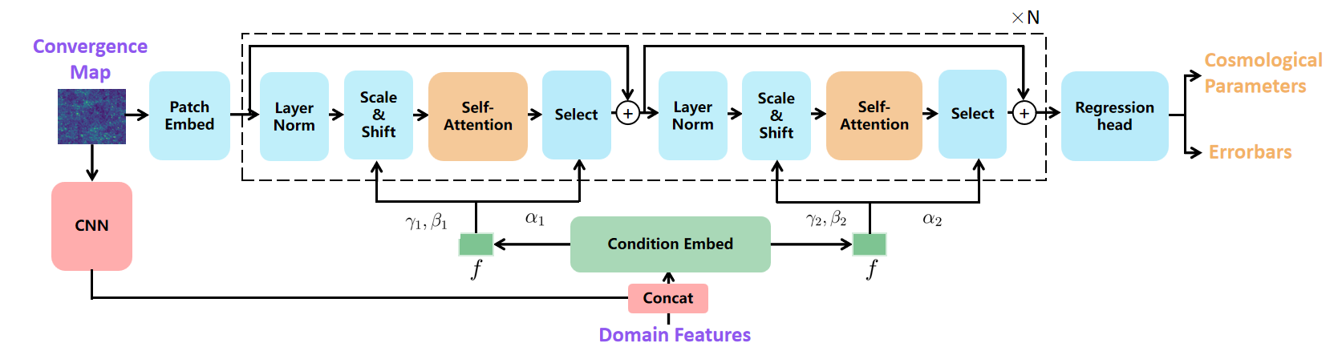
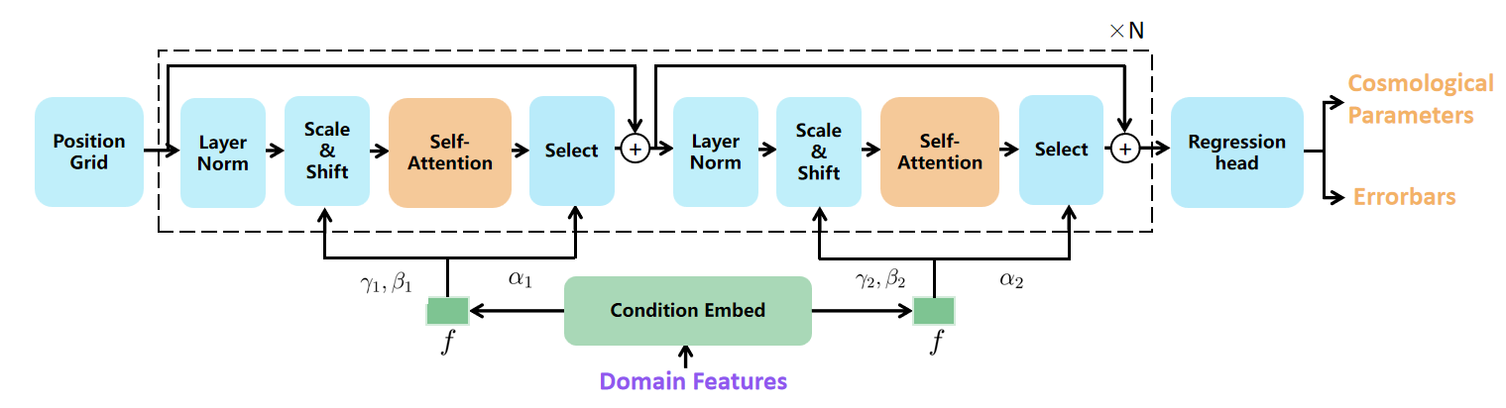
Stage 3: Ensemble Algorithm
Heterogeneity: (1) Domain Feature Combinations; (2) Architecture Variants.
Arch Variant 1
Unisolver + CNN
Arch Variant 2
Only Domain features

Slide 13
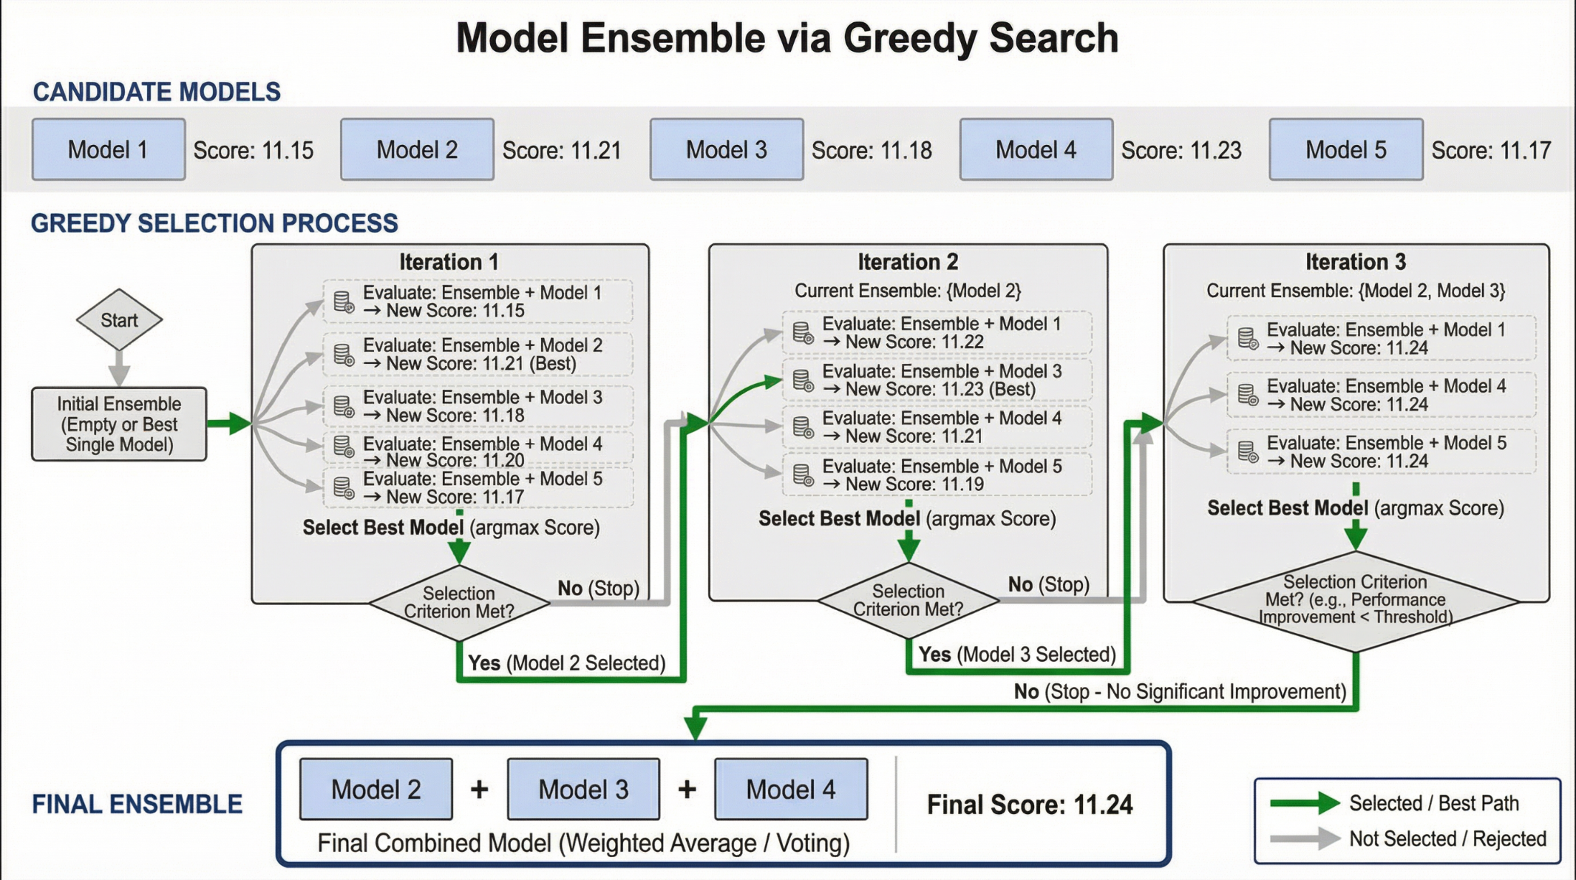
Stage 3: Greedy Model Selection Beyond All-in Ensemble
Huge ensemble Space
Combination of 11 Features
X
3 Architecture Variants
We need to reduce the search complexity
(Search Order) Adds single models one by one from high score to low score;
(Greedy Ensemble) Keep the newly added model only if it can improve the performance.

Slide 14
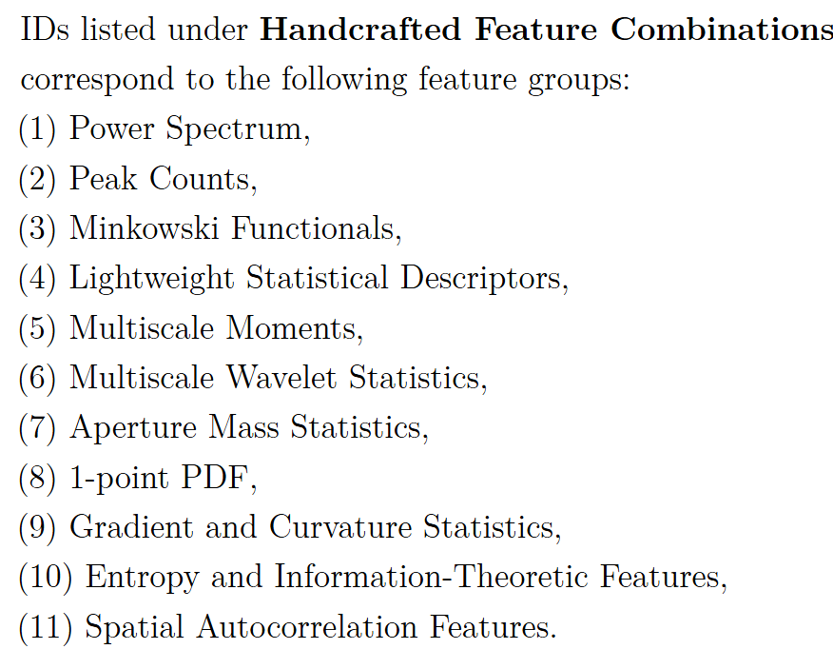
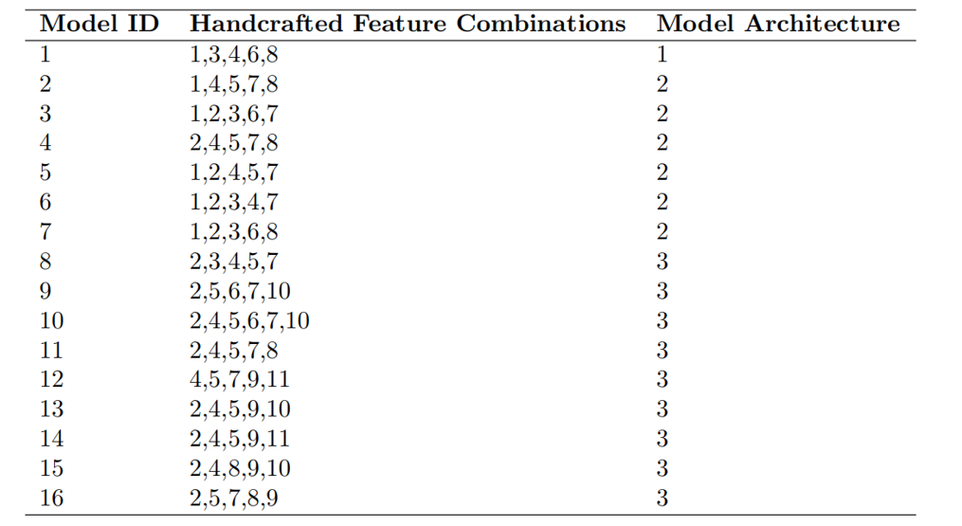
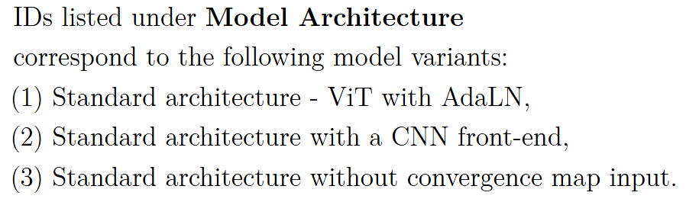
Stage 3: Results of the Greedy Search Ensemble
Test Score in the final holdout dataset: 11.2847
Rank: 3

Slide 15
Interesting Finding I —— Errorbar Distribution of Parameters
Errorbar of both parameters exhibits strong dependence on , but opposite trends.

Slide 16
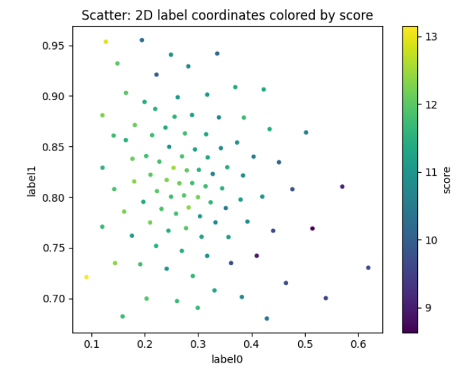
Interesting Finding II —— Score Distribution of Regions
Samples located in the bottom-right region of the parameter space tend to exhibit lower scores.
Possible reasons: observation hardness / insufficient data collection.

Slide 17


Thank You!
wenghk22@mails.Tsinghua.edu.cn / wuhaixu98@gmail.com
A new technical report is coming soon.
Code for Unisolver
https://github.com/thuml/Unisolver
Paper for Unisolver
https://openreview.net/pdf?id=r1ryQoI9iZ

